Slide 1


Data-Driven Storytelling Presentation:
Our sales mix towads more online retailer accounts shows greater sales growth.

Slide 2

Shifting Our Sales Mix Will
Drive Great Sales Growth.
While our overall sales performance has been good, it could be much better.
Closing some very poorly performing accounts would free up sales and marketing resources that would be more profitably invested elsewhere.
Over the last five years, our strongest sales growth has shifted to the online retailer account type.
Investing the freed-up sales and marketing resources into our online retailer accounts would drive the most sales growth.

Slide 3
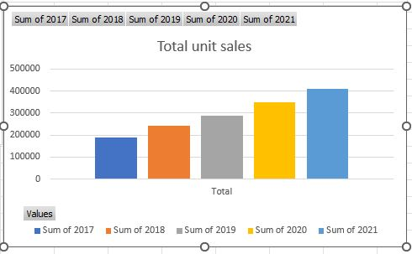
Overall our unit sales growth has been good with 5 years CAGR

Slide 4
Summary:
• While our overall sales performance has been good, it could be much better.
• Closing some very poorly performing accounts would free up sales and marketing
• Over the last five years, our strongest sales growth has shifted to the online retailer
account type.
accounts would drive the most sales growth.
• We recommend closing these underperforming accounts immediately and
launching an effort to identify the highest potential online retailer accounts for
increased sales and marketing investment.

